Slide 1





SWE3028-Fall-2024
Capstone Design Project
NLP-based
Psychological Diagnostic Diary
Final Presentation
런닝머신 팀(TEAM C)
김나영 김예담 박준현 방기호

Slide 2


CONTENTS
01
Recap
02
Progress
03
Design & Implementation
04
Challenges & Limitation
Capstone Design Project

Slide 3
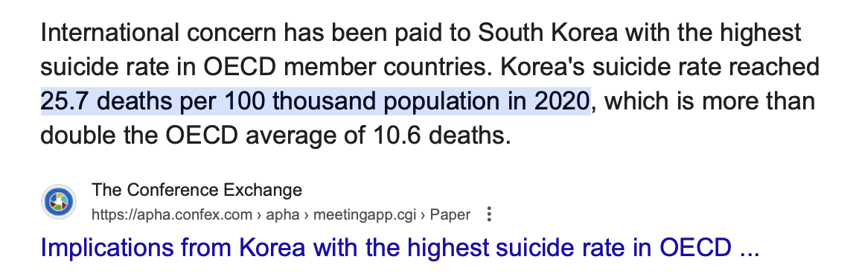
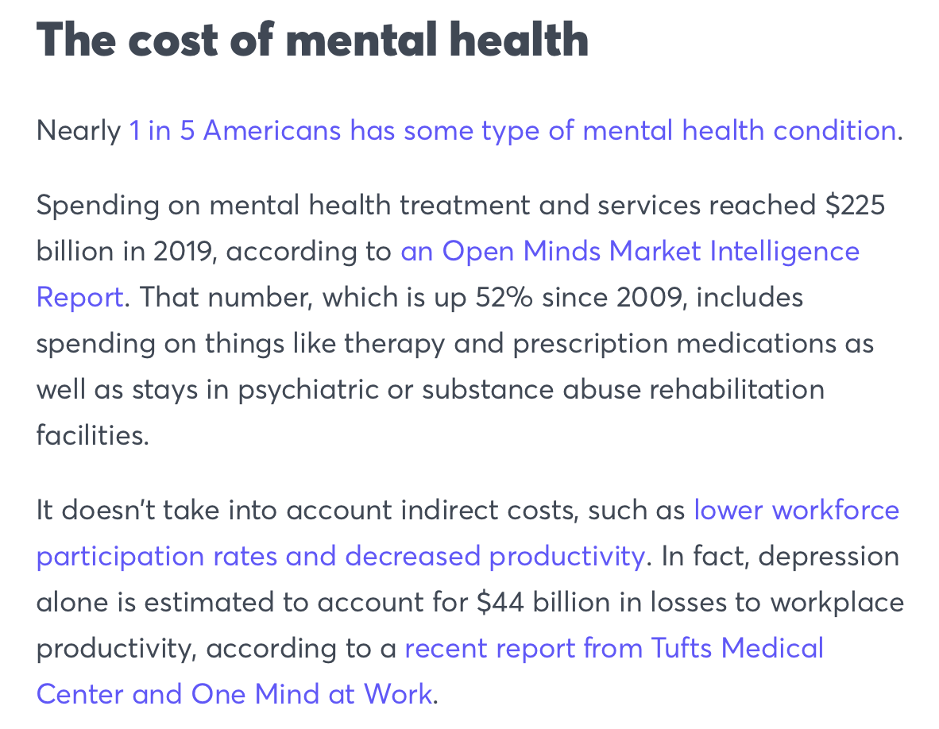
01. Recap - Motivation
Capstone Design Project

Slide 4
01. Recap - Motivation
Awareness of
Mental Health Issues
Early Detection,
Management of psychological conditions
Capstone Design Project

Slide 5
01. Recap - Objective
NLP-based
Psychological Diagnostic Diary
User’s Daily Thoughts and Feelings
Detect Subtle Emotional Shifts
Capstone Design Project

Slide 6









02. Progress - Milestone
Week 2-3 | Week 4-5 | Week 6-7 | Week 8-9 | Week 10-11 | Week 12-13 | Week 14-15
Topic Ideation
Topic Ideation
Data Collection
AI Model Design
Data PreProcessing
Model & Algorithm Implementation
UX/UI Design & Implementation
Debugging
Testing & Debugging
Capstone Design Project

Slide 7






02. Progress – Role Distribution
Yehdarm
Nayeong
Giho
Junhyun
AI Implementation
Front-end
Back-end
Team Leader
UX / UI design
Capstone Design Project

Slide 8
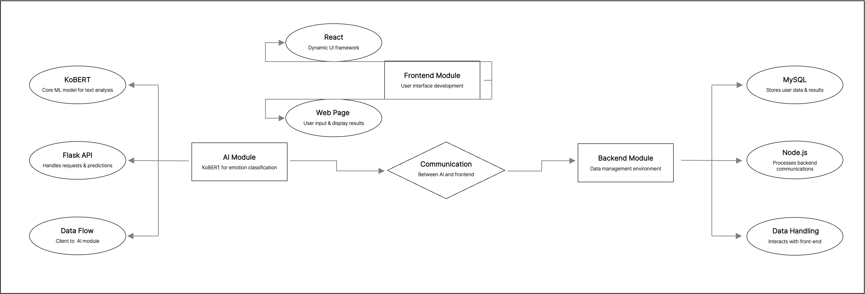
03. Design & Implementation - Architecture
Capstone Design Project

Slide 9
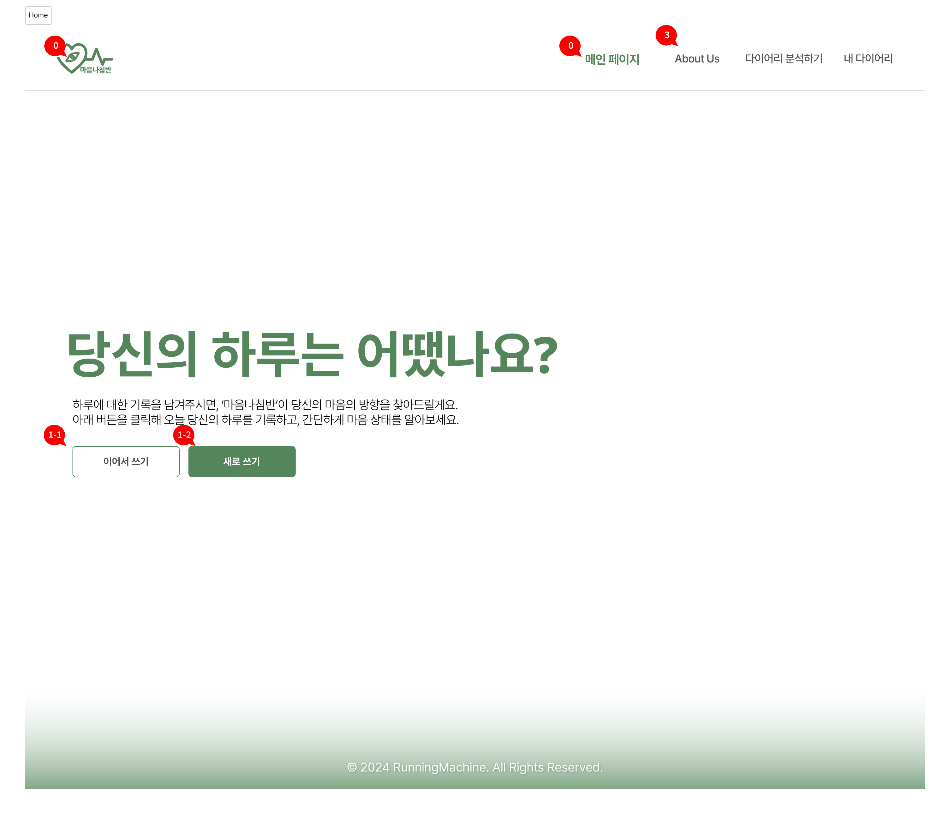
03. Design & Implementation – UX/UI
Capstone Design Project

Slide 10
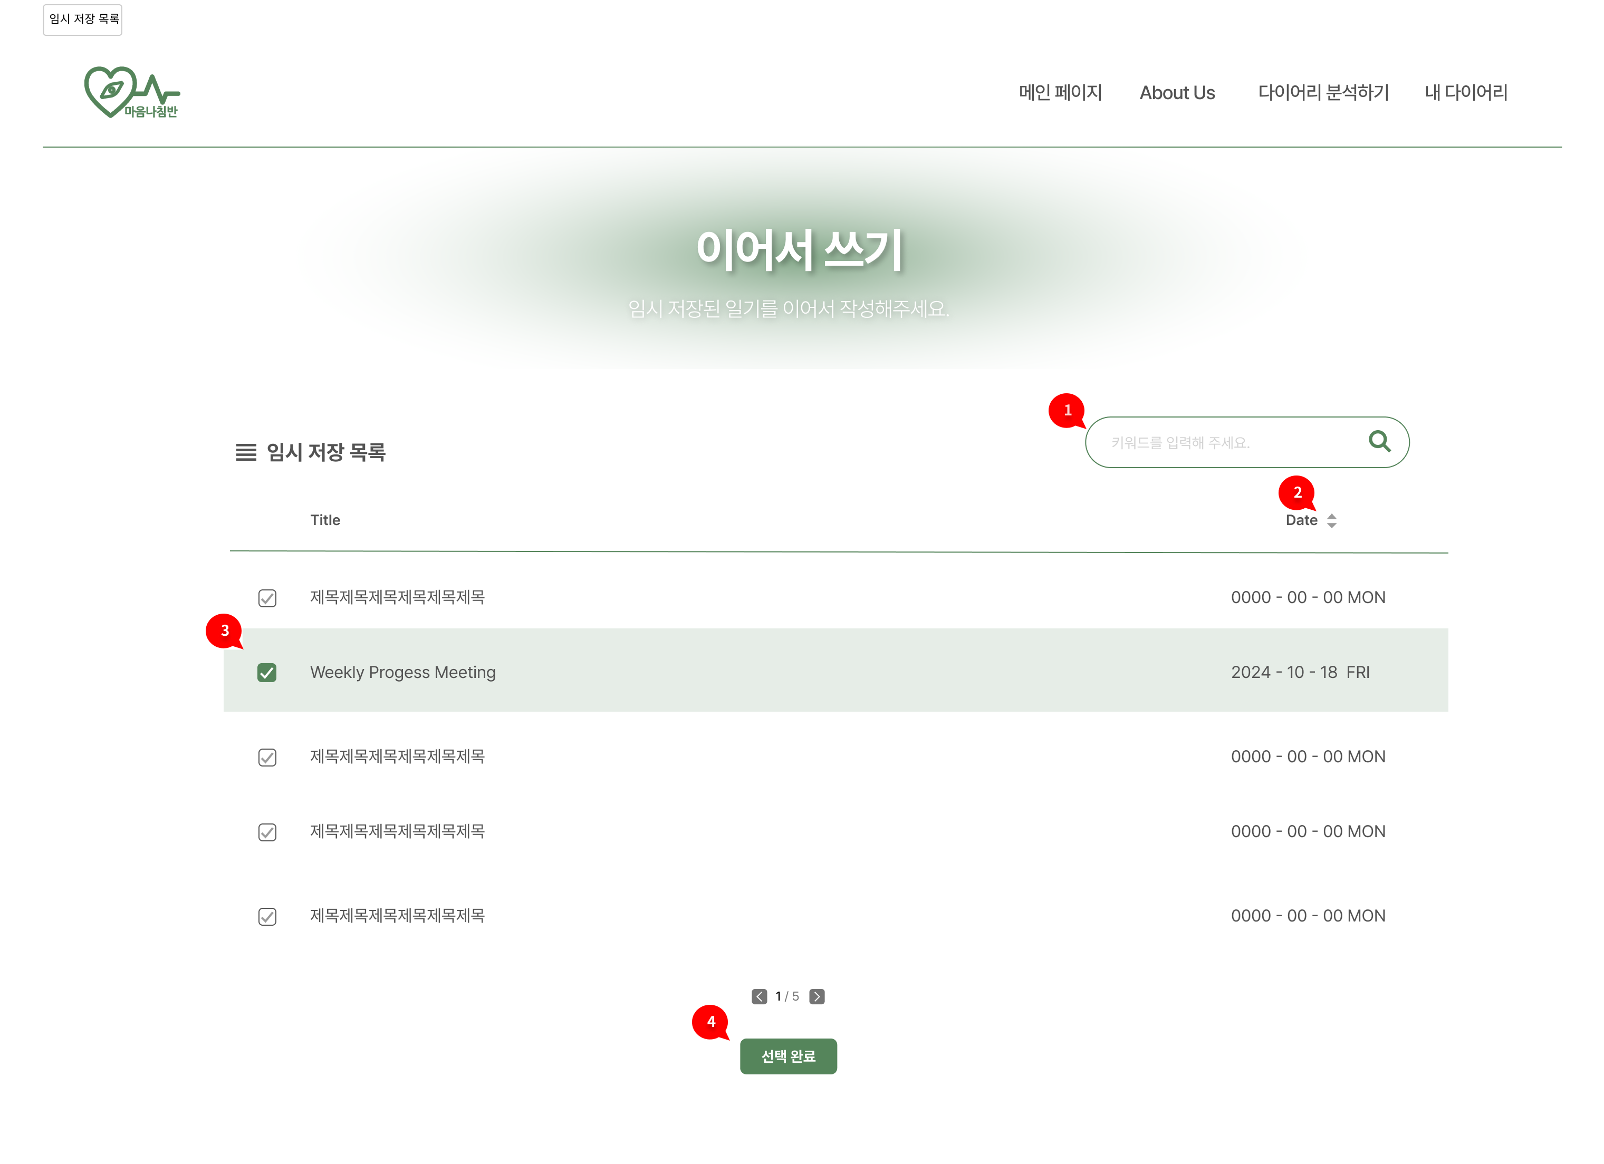
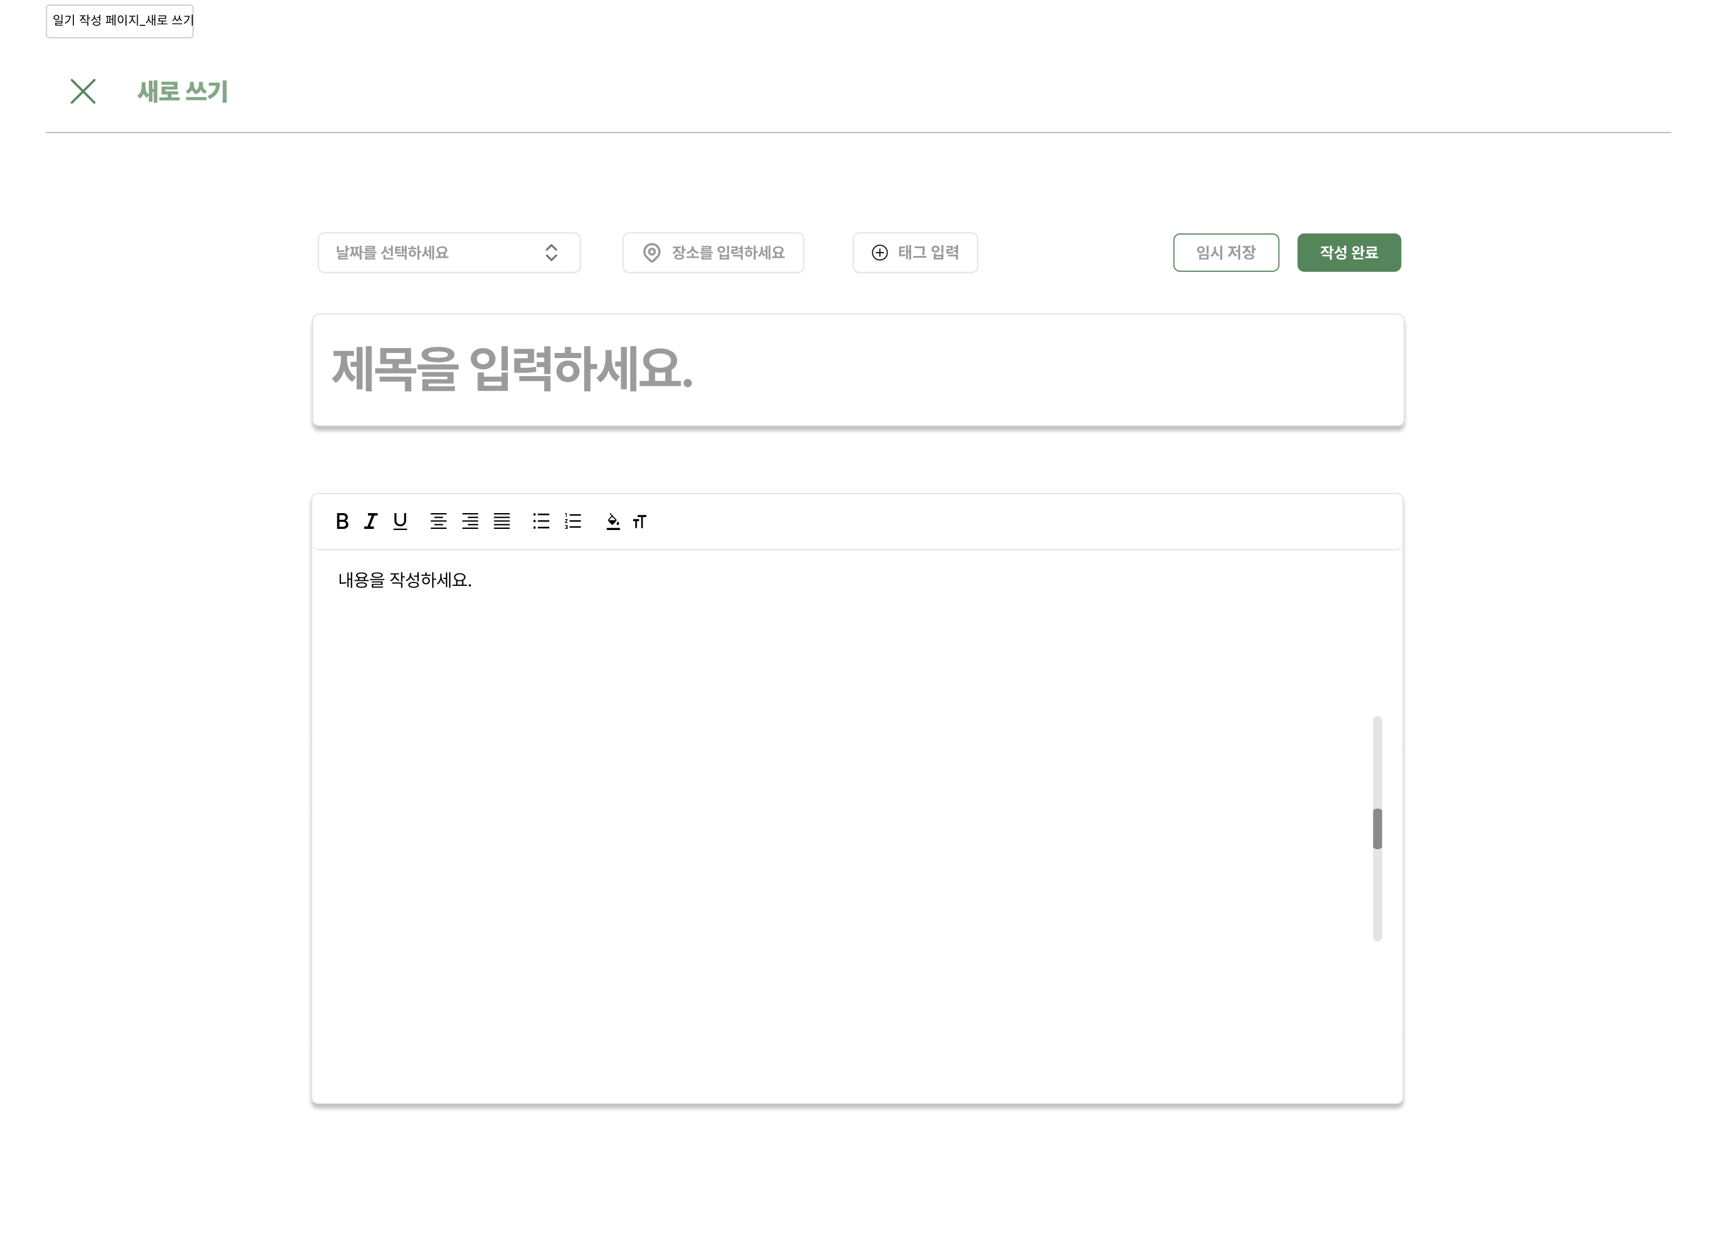
03. Design & Implementation – UX/UI
Capstone Design Project

Slide 11
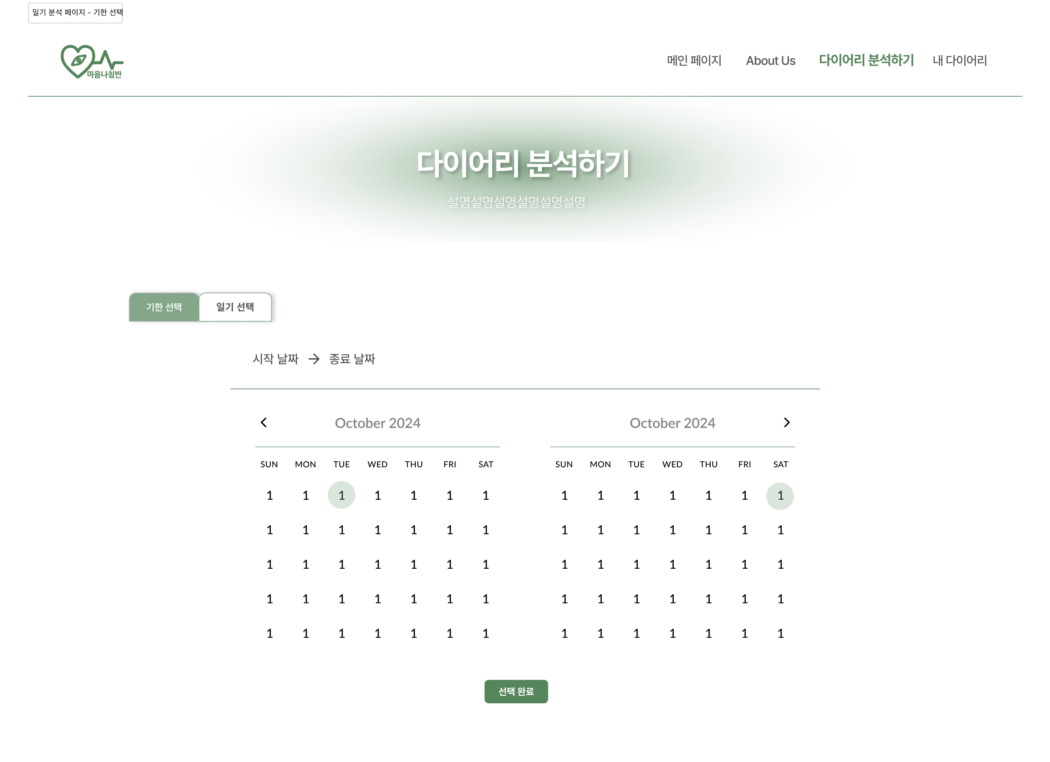
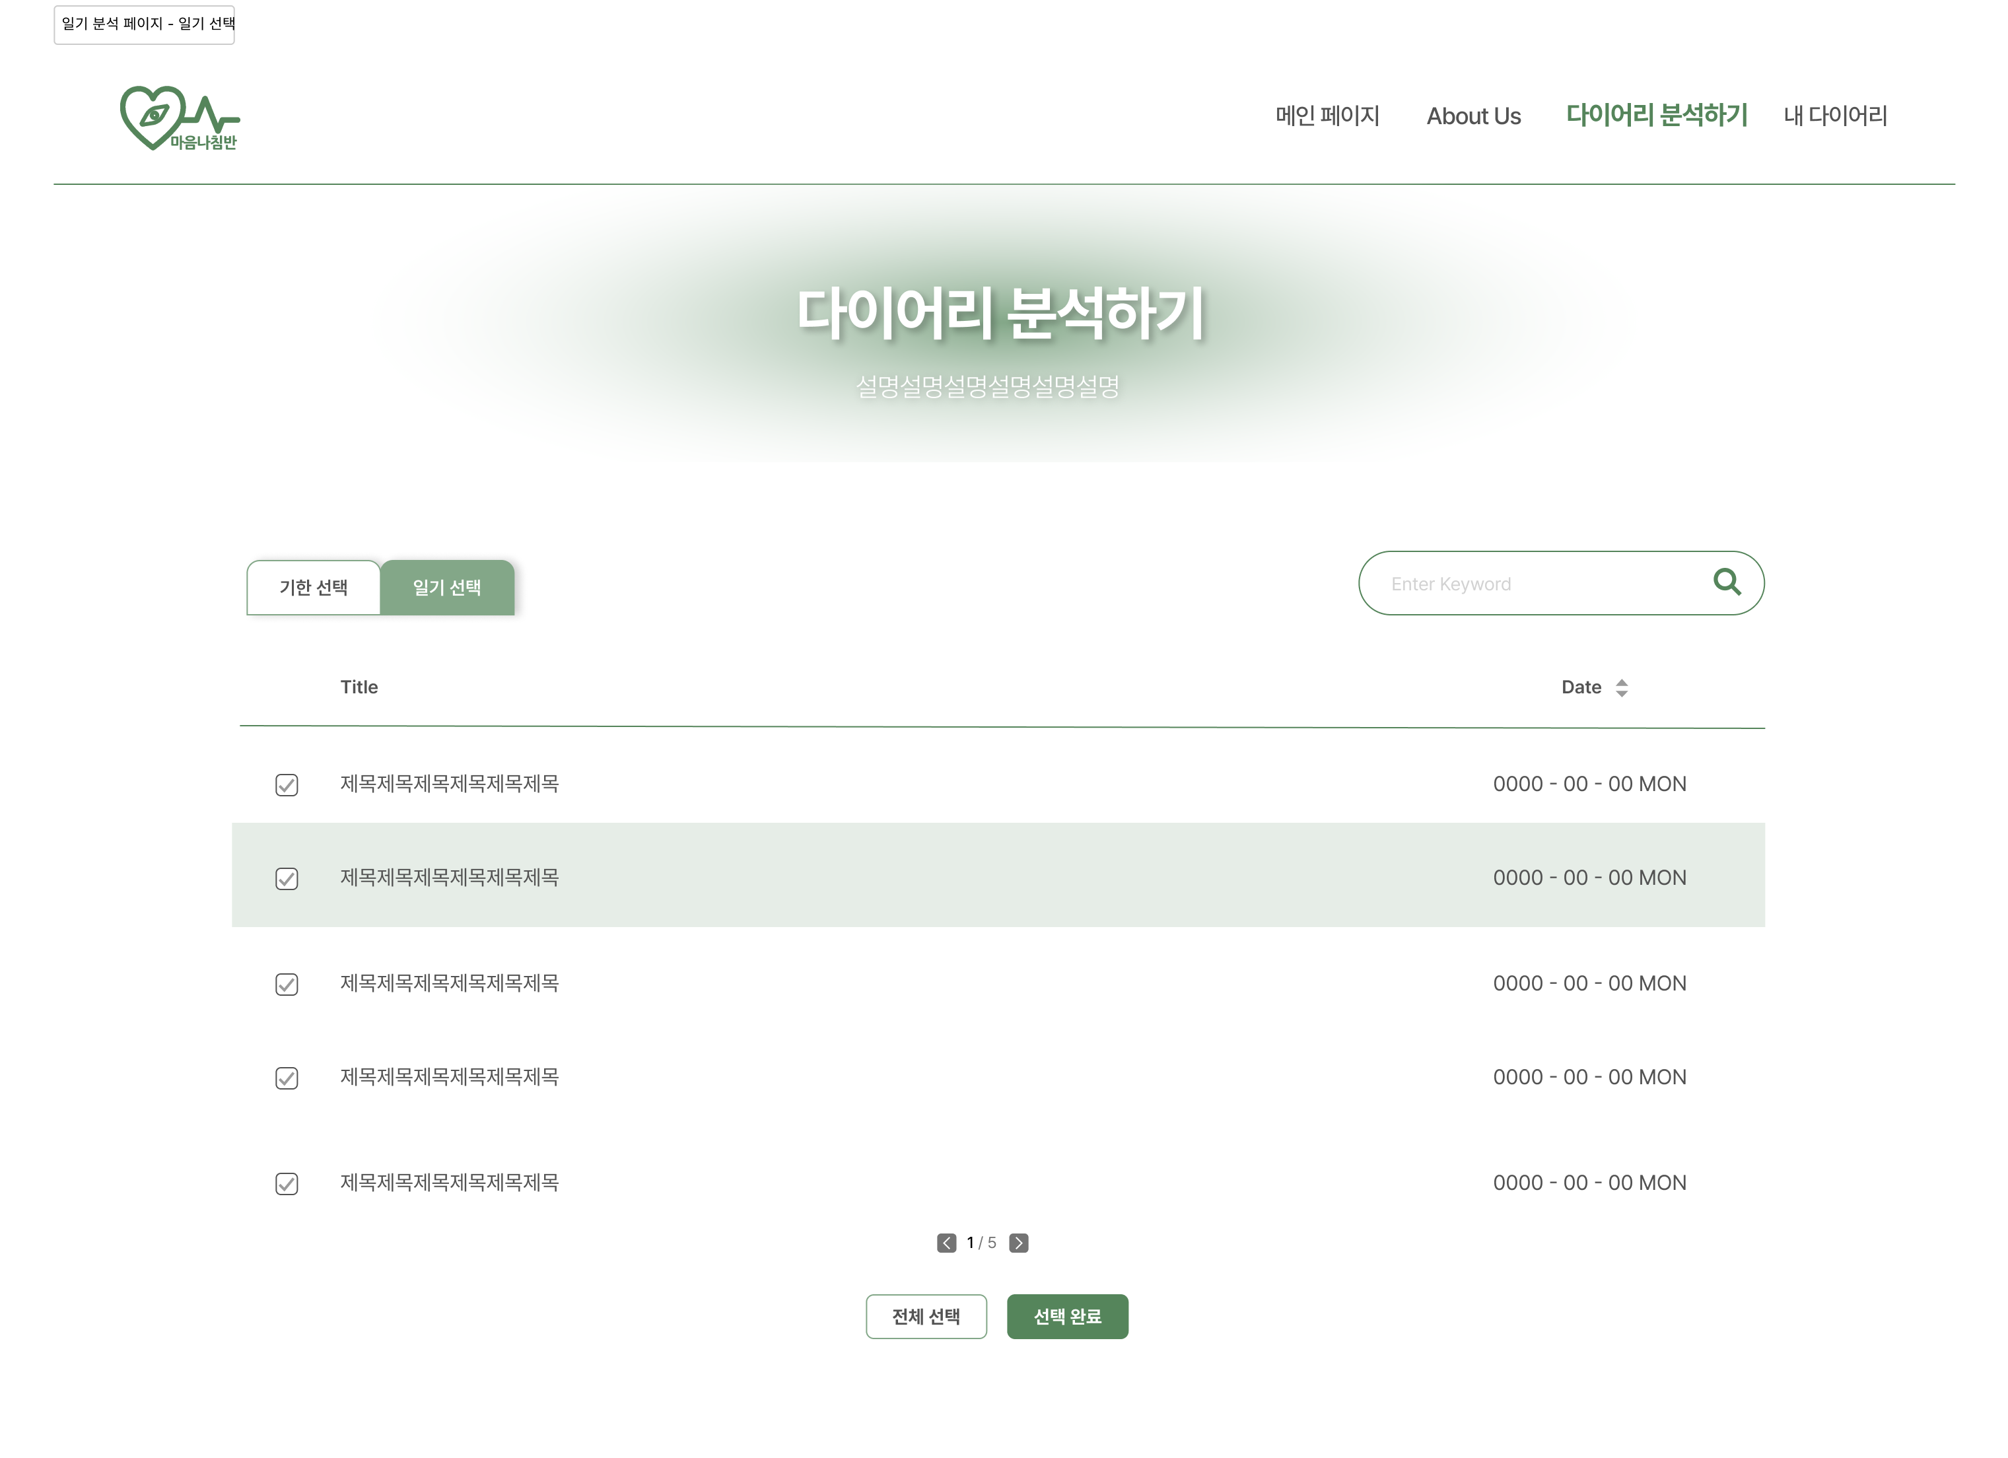
03. Design & Implementation – UX/UI
Capstone Design Project

Slide 12
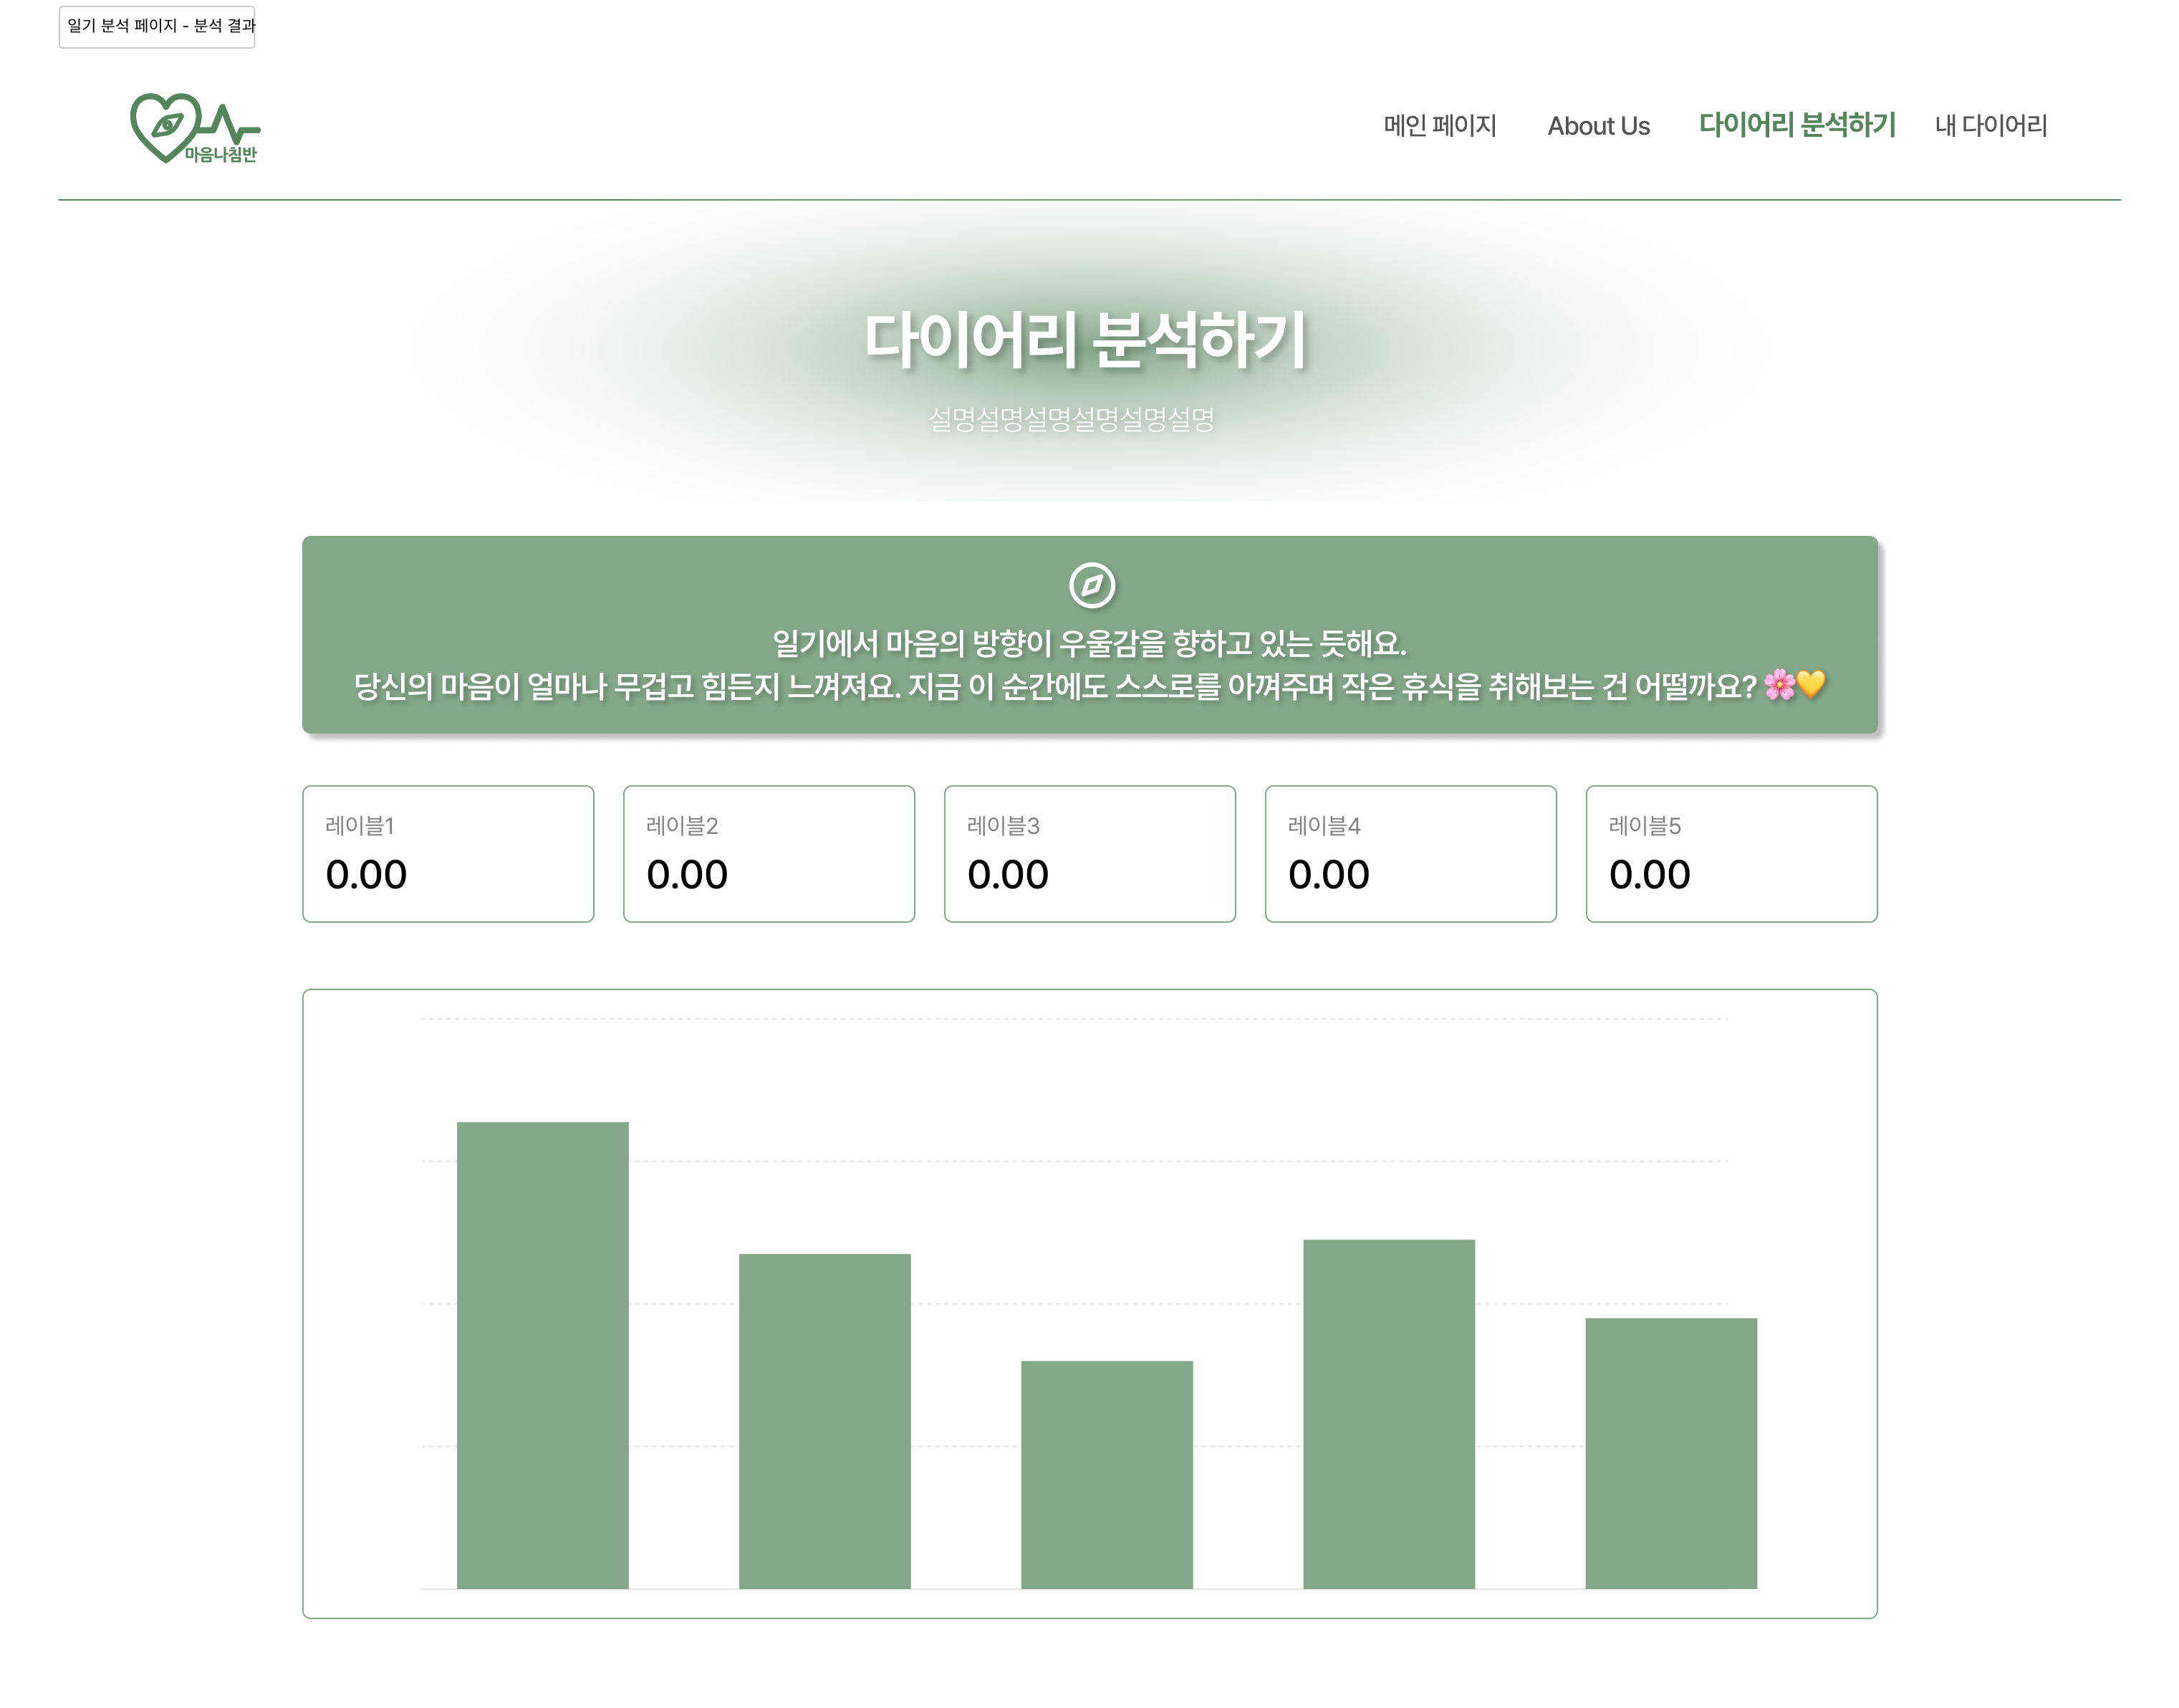
03. Design & Implementation – UX/UI
Capstone Design Project

Slide 13


03. Design & Implementation – AI Model
Wellness Conversation Script Dataset
Depression / Sadness / Loneliness / Anger / Lethargy / Abnormal Emotional Control
Sense of Loss / Loss of Appetite / Increase in Appetite / Insomnia
Nervousness / Fatigue / Feeling of Guilt / Loss of Concentration
Decrease in Confidence / Decline in Self-esteem
Feeling of Despair / Suicidal Impulse / Feeling of Insecurity
19 emotional labels in total
Capstone Design Project

Slide 14
03. Design & Implementation – AI Model
Algorithm Design
raw data
mask insertion
fill mask using KoELECTRA
augmented data
fine-tuning using KoBERT
Capstone Design Project

Slide 15

03. Design & Implementation – AI Model
Only Insertion Augmentation → Only 8 labels
Hyperparameter Tuning
Test Acc | F1-score | Precision | Recall | Cosine Similarity
0.872 | 0.871 | 0.872 | 0.872 | 0.973
Capstone Design Project

Slide 16
03. Design & Implementation – AI Model
Learning rate: [5e-5, 3e-5]
Batch size: [16, 32]
Warmup ratio: [0.1, 0.2]
Dropout rate: 0.1
Epochs: 10
Max grad norm: 1
Log interval: 200
Max length: 512
Learning rate: 5e-5
Batch size: 16
Warmup ratio: 0.2
Dropout rate: 0.1
Epochs: 10
Max grad norm: 1
Log interval: 200
Max length: 512
Capstone Design Project

Slide 17

03. Design & Implementation – Front-end
Capstone Design Project

Slide 18


03. Design & Implementation – Back-end
Capstone Design Project

Slide 19
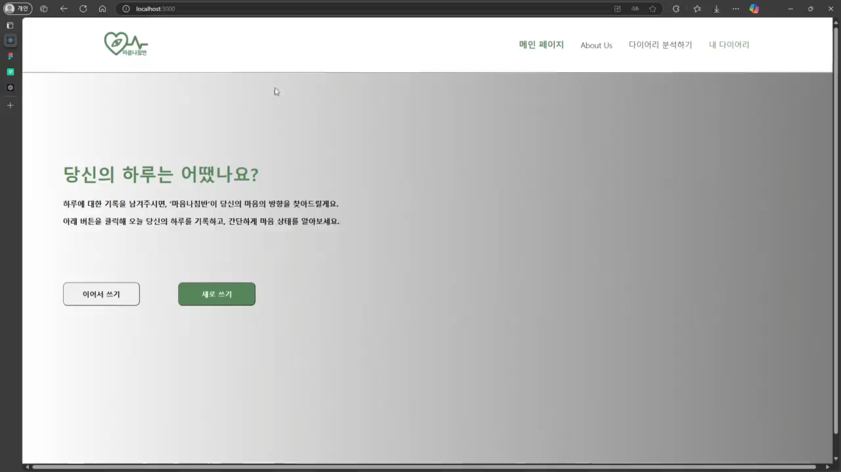
03. Design & Implementation – Demo
Capstone Design Project

Slide 20
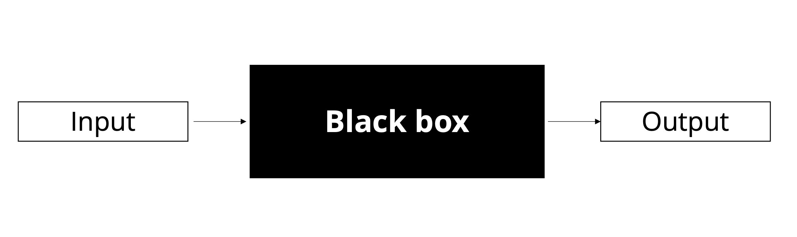
04. Challenges & Limitation
Challenge – Black box model
limitation
Black box
XAI (Explainable AI)
Capstone Design Project
Notes:
Challenge in AI part

Slide 21
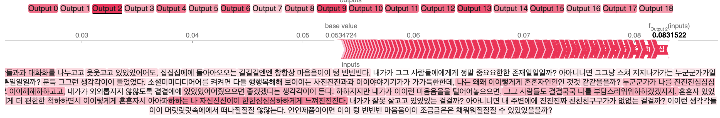
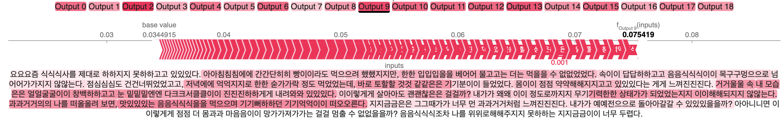
04. Challenges & Limitation
Solution - Model Explainability [LIME]
loneliness
Loss of
appetite
Capstone Design Project
Notes:
Challenge Solution in AI part

Slide 22

04. Challenges & Limitation
Challenge – Low TPS and Bottleneck
Capstone Design Project
Notes:
Challenge Solution in AI part

Slide 23
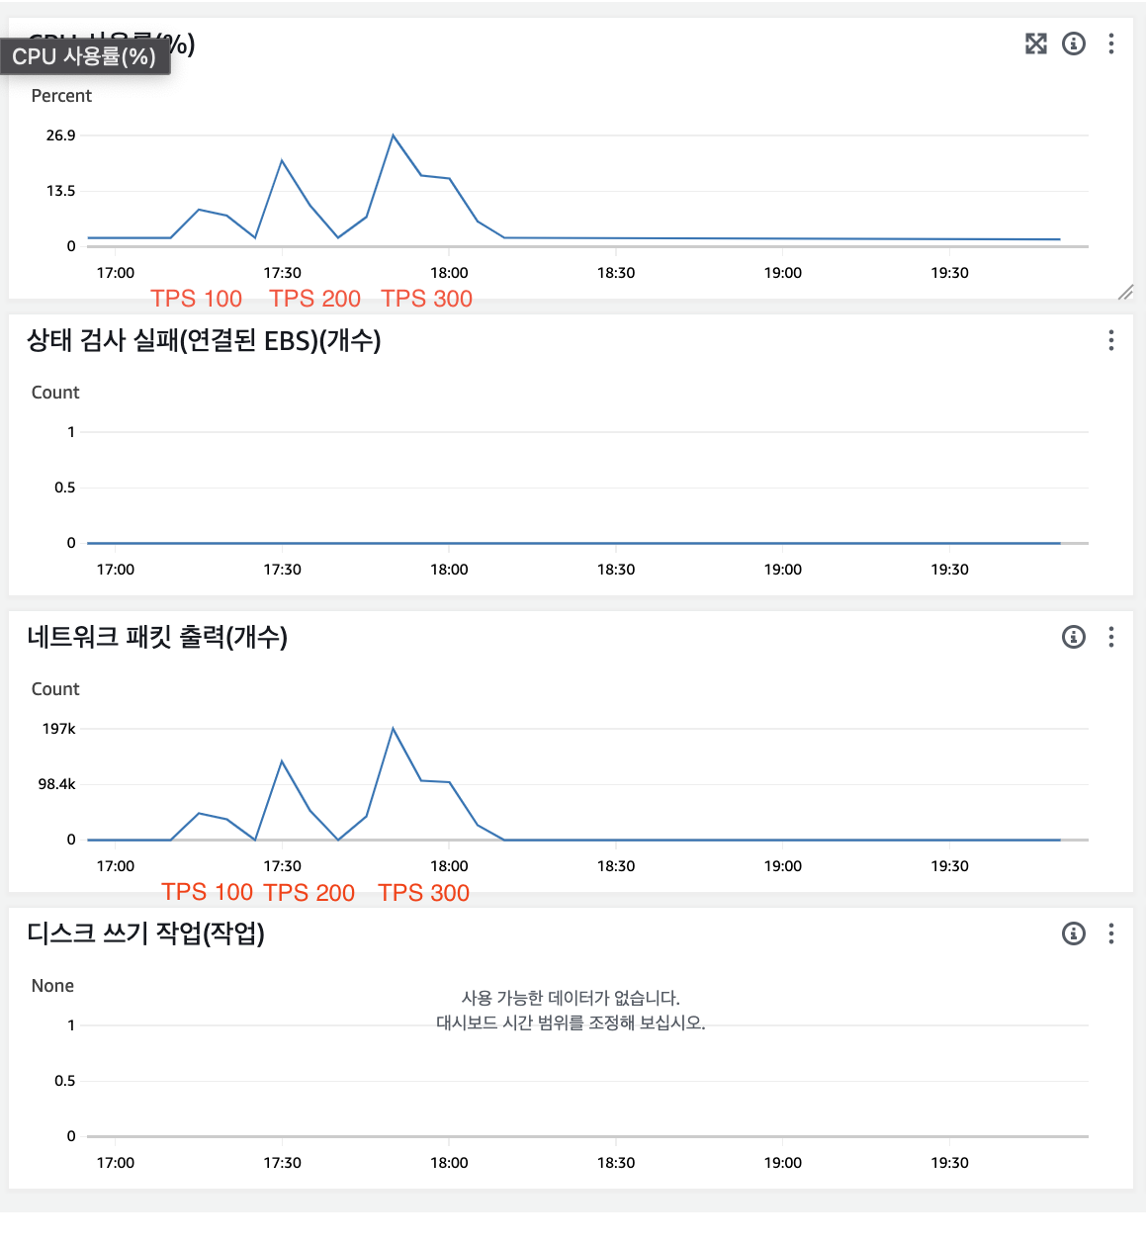
04. Challenges & Limitation
CPU 사용률
Capstone Design Project
Notes:
Challenge Solution in AI part

Slide 24
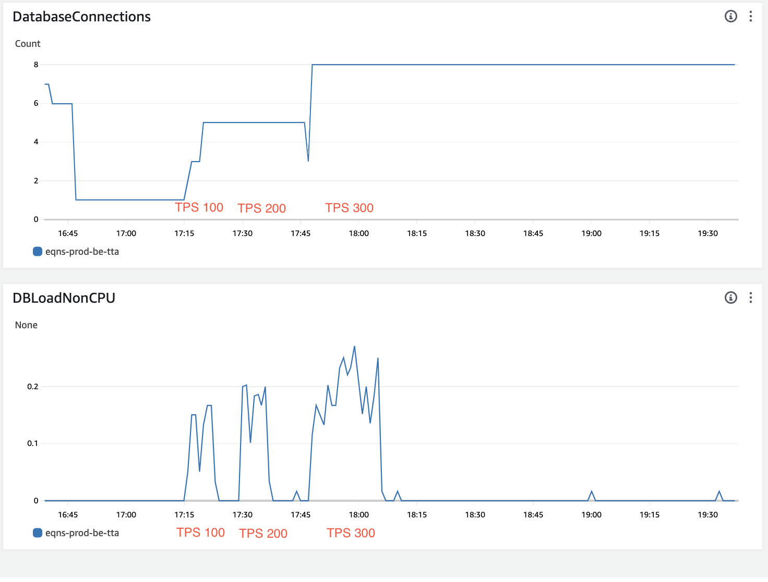
04. Challenges & Limitation
Capstone Design Project
Notes:
Challenge Solution in AI part

Slide 25
04. Challenges & Limitation
Loneliness: 0.086
Loneliness: 0.084
Suicidal: 0.054
Suicidal: 0.052
어제 너무 많은 일들이 있었어. 너무 힘들었어.
친구들, 부모님과 다퉜어.
내 일이 잘 풀리지도 않아.
그냥 너무 힘들어.
어제 너무 많은 일들이 있었어. 너무 힘들었어.
친구들, 부모님과 다퉜어.
내 일이 잘 풀리지도 않아.
그냥 너무 힘들어.
그만하고 싶어. 그냥 죽어버리고 싶어.
내일 옥상에 가볼 거야.
그리고 삶을 끝내야지.
Capstone Design Project
Notes:
Limitation in AI part

Slide 26
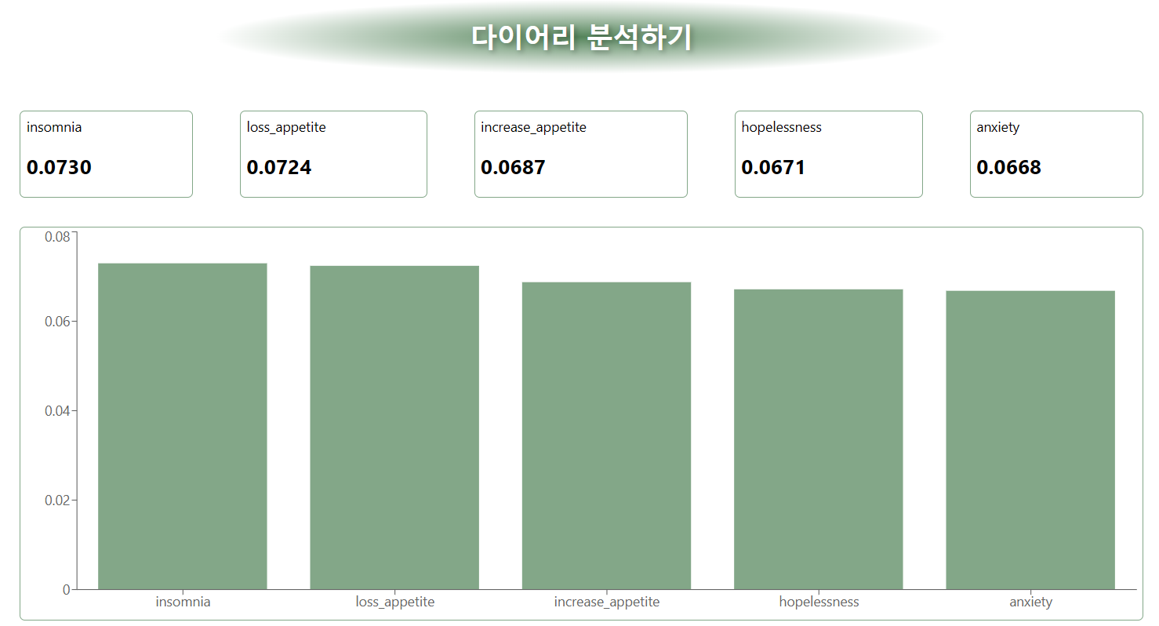
04. Challenges & Limitation
Revealing the presence of negative emotions
that one may not have been aware of.
Notes:
Limitation in AI part

Slide 27


Q & A
NLP-based Psychological Diagnostic Diary
Capstone Design Project

